Slide 1
Lecture 9
Trees

Slide 2
Main Points
Tree definition
Use of a tree
Types of trees
Implementations
Exercises

Slide 3
Tree: a definition
A tree consists of nodes connected using edges
  In computer programs, nodes often represent entities such as people, car parts, operators, operands…..
  The edges between the nodes represent the way the nodes are related
    pointers!
There are different types of trees
  Multiway
  Binary

Slide 4
Definitions
There are many terms used to describe particular aspects of a tree: most of them are related to real-world trees or family relationships (as in parents and children)
Path: the resulting sequence of nodes to go from one source node to a destination node
Root: The node at the top of the tree
Parent: Any node except the root has exactly one edge running upward to another node
Child: Any node may have one or more lines running downward to other nodes
Leaf: any node without children
Subtree: Any node may be considered to be the root of a subtree, which consists of its children and it children's children

Slide 5
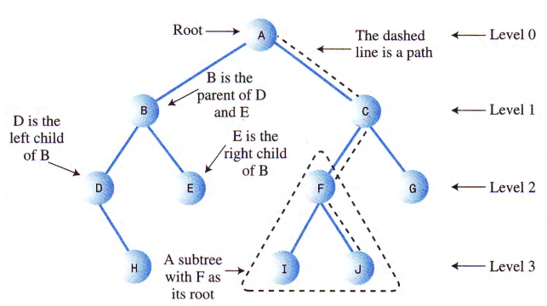
Tree Terms

Slide 6
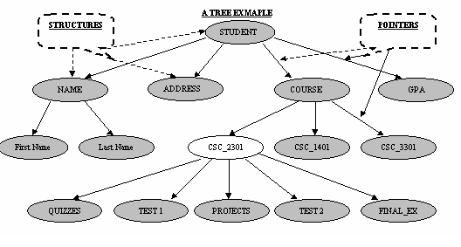
Multiway Tree: a node can have more than two children

Slide 7
Binary Trees

Slide 8
Binary Trees
A tree in which a node can have at most two children
One of the fundamental data storage structures used in programming.
  Why might you want to use a binary tree?
    It combines the advantages of two other structures: an ordered array and a linked list
      You can search a Binary Tree as quickly as you can an ordered array
      You can also delete and insert quickly as you can with a linked list
    Efficiency!!
      O(log₂ N)

Slide 9
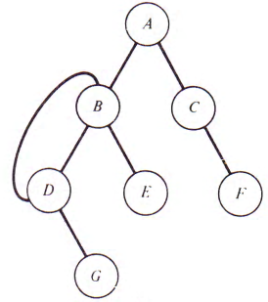
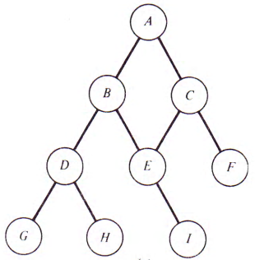
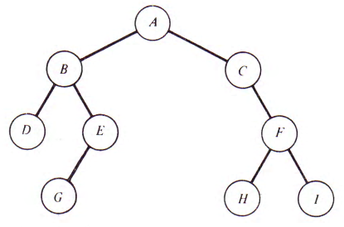
Binary Trees

Slide 10
Typical Use of Binary Tree
Expression Trees
  Since the operators (Binary and Unary) need at most 2 operands, the ‘Binary Tree’ is very suitable
  leaves contain ‘Values/Operands’
  All other nodes contain ‘Operators’
  Refer to the next slide

Slide 11
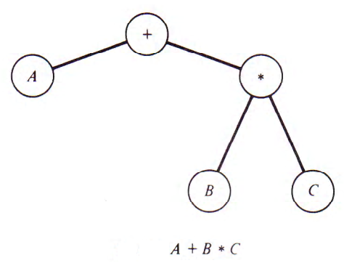
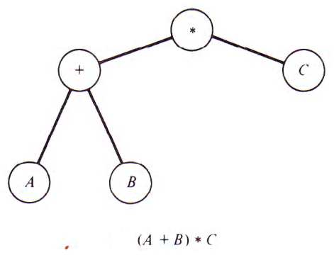
Math Expressions and their Tree Representations
Draw the tree representation for the following math representations:
(A + B * (B-C)) * (D - (E * F))
( A + B * C) + ((A + B) * C)

Slide 12
Traversing a Tree
Another common operation is to traverse a binary tree
  To pass through the tree, enumerating each of its nodes once: visiting nodes
The order in which the nodes are visited is from first to last.
  Three different ways
    Preorder
    Inorder
    Postorder

Slide 13
Preorder, inorder, postorder
Preorder:
  Visit the root
  Traverse the left subtree in preorder
  Traverse the right subtree in preorder
Inorder:
  Traverse the left subtree inorder
  Visit the root
  Traverse the right subtree inorder
Postorder:
  Traverse the left subtree in postorder
  Traverse the right subtree in postorder
  Visit the root
Refer to the next example

Slide 14
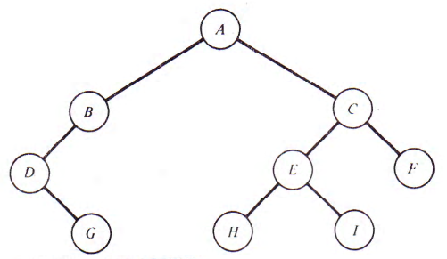
Preorder, inorder, and postorder: an example 1
Refer to the following tree:
Preorder?
Inorder?
Postorder?
ABDGCEHIF
DGBAHEICF
GDBHIEFCA

Slide 15
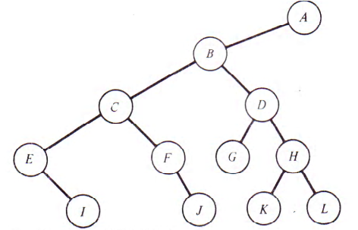
Preorder, inorder, and postorder: another example
Refer to the following tree:
Preorder: ABCEIFJDGHKL
Inorder: EICFJBGDKHLA
Postorder: IEJFCGKLHDBA

Slide 16
Binary Tree - Representing a math expression: containing operands and binary operators
Refer to the following binary tree:
Watch what will
happen if the tree
is traversed in:
Postorder?
  AB+C*  Postfix Expression
Inorder?
  A+B*C  Infix Expression!!
    An expression whose infix form requires parentheses can not be retrieved by a simple inorder traversal
Preorder?
  *+ABC  Prefix Expression

Slide 17
Binary Tree - Representing a math expression: Implementation
Given a postfix expression we would like to write a C program that allows the user to print the content of a binary tree, that you should build while reading the postfix expression, to display the infix and the prefix expressions

Slide 18
Algorithm to use
1. Examine the element in the postfix expression
  If it is an operand
    Create a leaf node: having no child
    Copy the operand in the data part of the node
    Push the node address in the stack
  If it is an operator
    Create a node
    Copy the operator in the data part of the node
    Pop address of a node from the stack and assign it to node->right
    Pop address of a node from the stack and assign it to node->left
    push the node address into the stack
  If there is more input go to step 1
  If there is no more input, pop the address from the stack, which is the address of the root node of the expression tree

Slide 19

Implementation:
next Homework

Slide 20
Binary Trees: BST
Many algorithms that use a binary tree proceed in two phases:
  Building a binary tree
  Traversing the tree
Example: Consider the following sorting method: Given a list of numbers in a text file, we need to print them in ascending order. Duplicate number should not be inserted.
  If the read number is less than the content of the node, place it to the left
  If the read number is greater than the content of the node, place it to the right
Assume that the file consist of the following numbers:
14 15 4 9 7 18 3 5 16 4 20 17 9 14 5

Slide 21
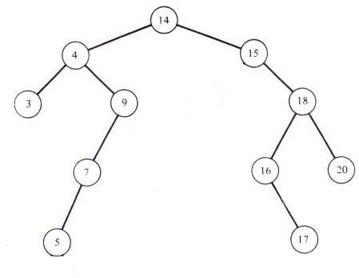
Binary Tree: Cont..
After reading the numbers from the file, the binary Tree would look like this:
Such a binary tree, where all the elements in the left subtree of a node n are less than the content of n, and all the elements in the right subtree of n are greater than n is called Binary Search Tree or BST
What will be the output if the tree is traversed inorder?

Slide 22
BST: More Details
BST is a tree whose nodes’data are ordered in a way making the search operation very quick: O(log(n))
The key element in a BST node is always smaller than the one at the right and greater than the one at the left
No duplicate keys
  However you can add a count field to the node structure to track multiple nodes (with the same key)

Slide 23
Traversing a Tree: inorder
How can we use recursion to display the content of a Tree in order?
void print_inorder(root){
If(root==NULL)
return;
Else{
print_inorder(root->left);
printf(“%d ”,root->element);
print_inorder(root->right);
}
}

Slide 24
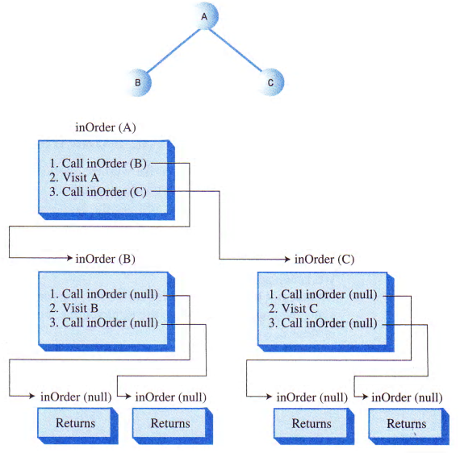
Traversing a Tree inorder: illustration

Slide 25
Problem To Solve
Assume that we have a list of numbers saved in a text file. Implement the following functions
  Construct a BST
  Traverse the tree inorder

Slide 26
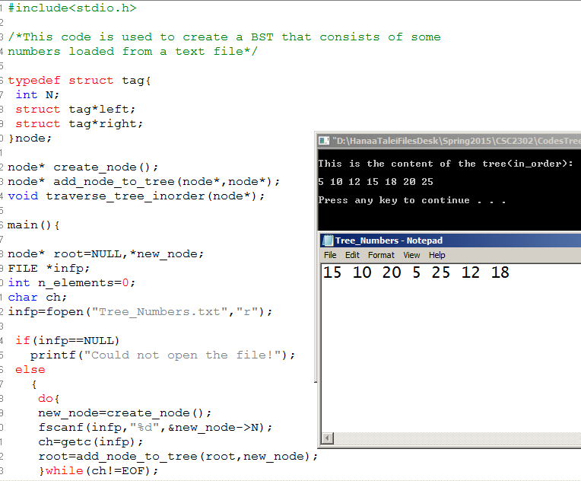
Code

Slide 27
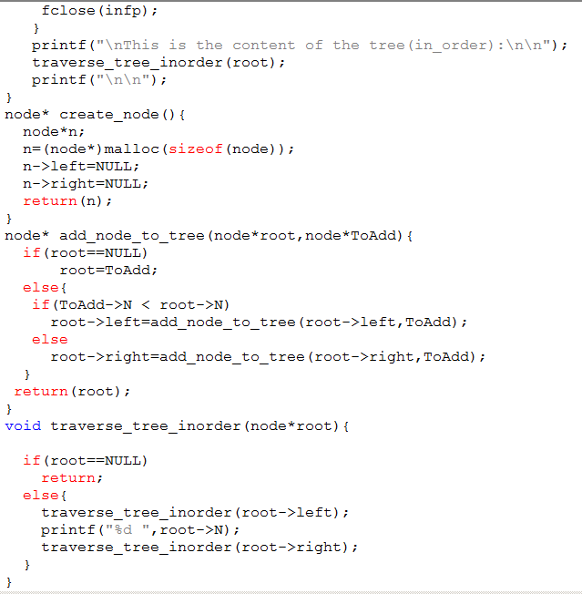


Slide 28
Next: Searching and Deleting

Slide 29
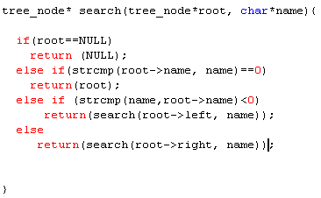
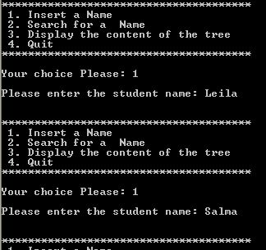
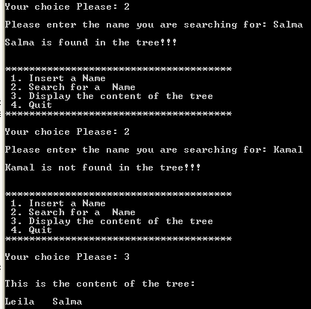
Searching in a BST: Illustration

Slide 30
Deleting a Node
Deleting a node is the most complicated common operation required for the binary search tree
  Deletion is important in many tree applications
You start by finding the node you want to delete; once found there are 3 cases to consider:
  The node is a leaf
  The node has one child
  The node has two children

Slide 31
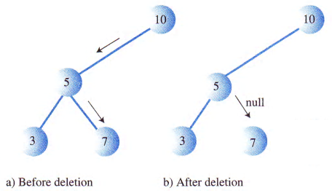
Delete a leaf node
To delete a leaf node, you simply change the appropriate child field in the parent node to point to NULL instead of to the node

Slide 32
Delete a node with one child
This case is not so bad either!
  The node has two connections: to its parent and to its only child
  What we want is to snip the node out of the sequence
    You can connect its parent directly to its child
    This involves changing the appropriate reference in the parent (left or child) to point to the deleted node’s child
    Refer to the next slide

Slide 33
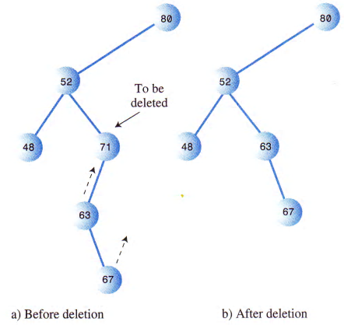
Delete a node with one child

Slide 34
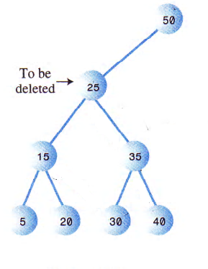
Delete a node that has two children
The fun begins!
If the deleted node has two children, you can’t just replace it with one of these children

Slide 35
Delete a node that has two children
Remember in a binary search tree, the nodes are arranged in order of ascending keys.
To delete a node with 2 children
  2 alternatives:
      Replace the node with the ‘Highest’ child in the left subtree
      Replace the node with the ‘smallest’ child in the right subtree

Slide 36
Using a BST of numbers:
create, traverse, search and delete

Slide 37
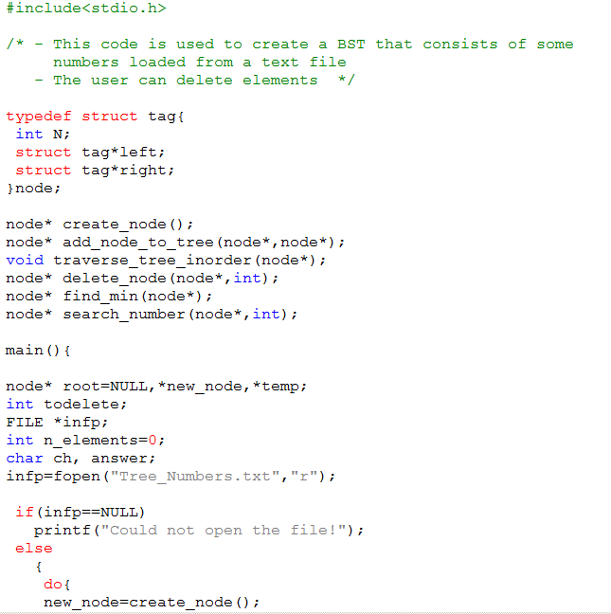
Code

Slide 38
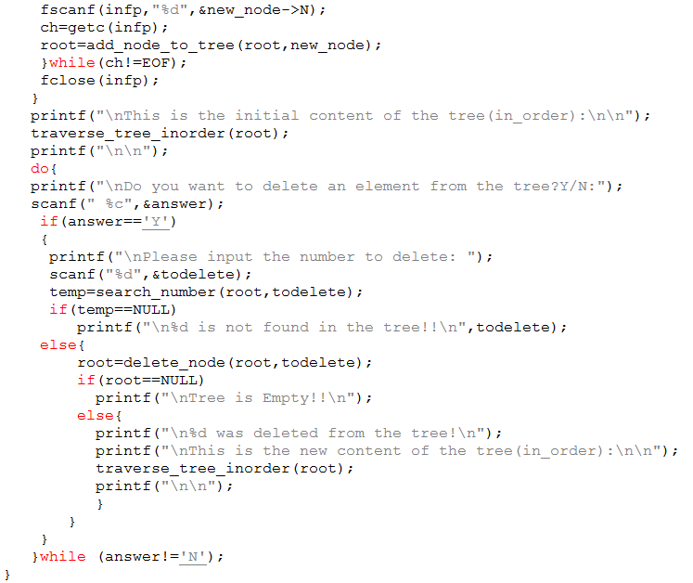
Code

Slide 39
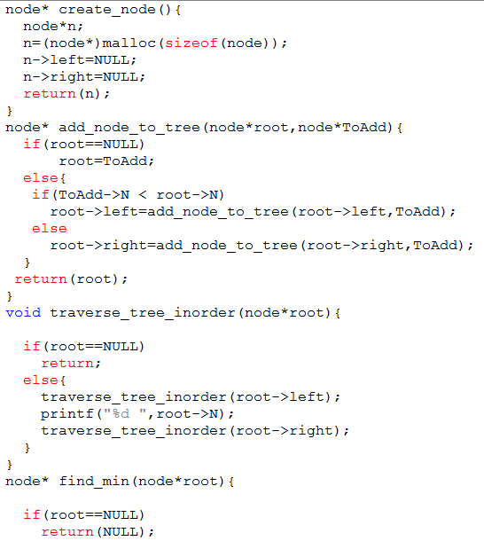
Code

Slide 40
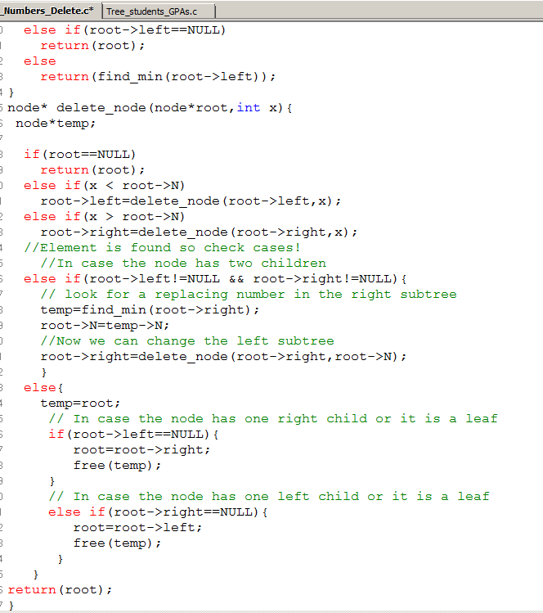

Slide 41
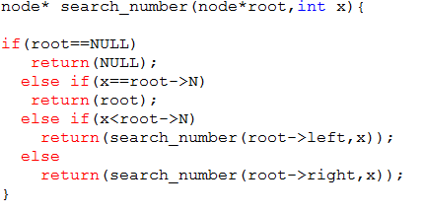

Slide 42
Using a BST of names:
create, traverse, search, and delete

Slide 43
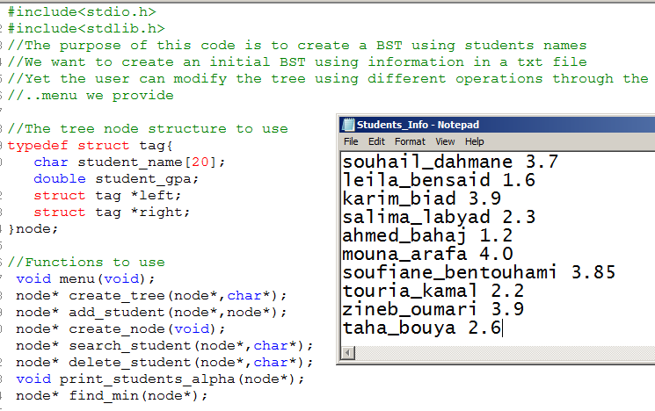

Slide 44
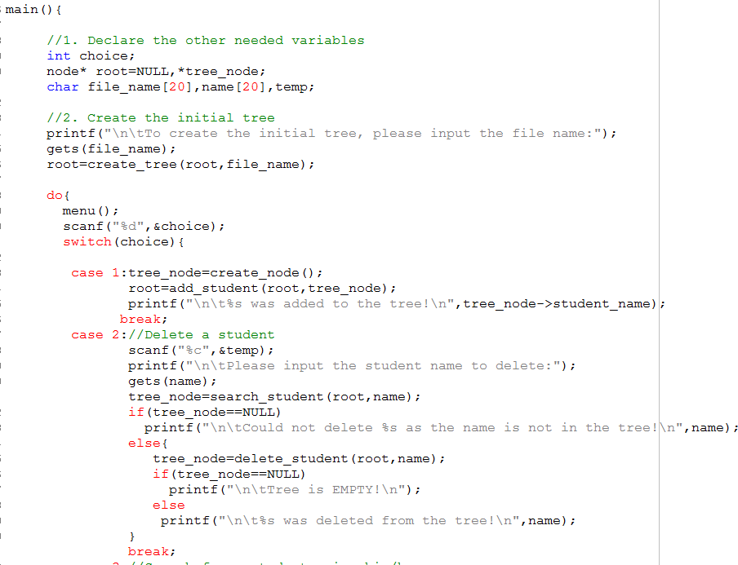

Slide 45
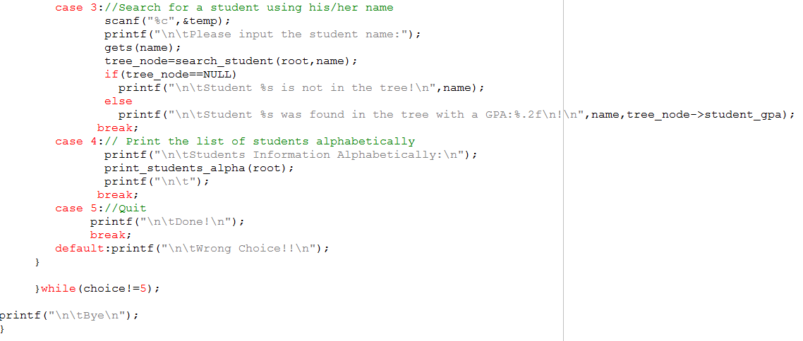

Slide 46
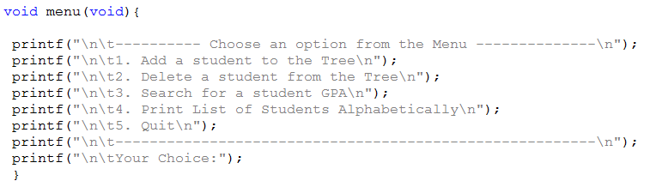
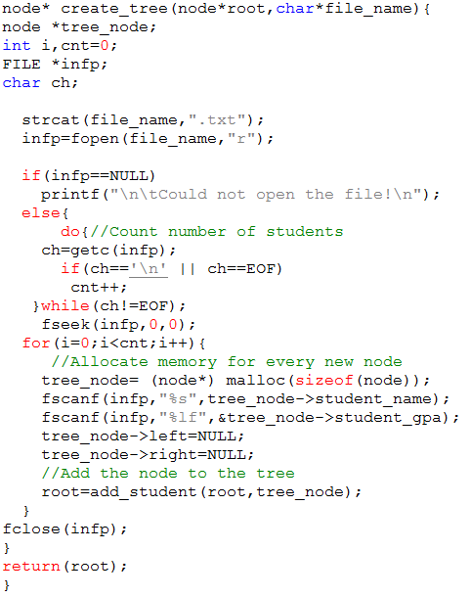

Slide 47
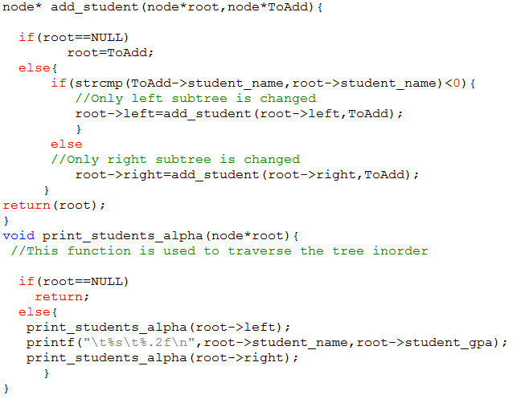
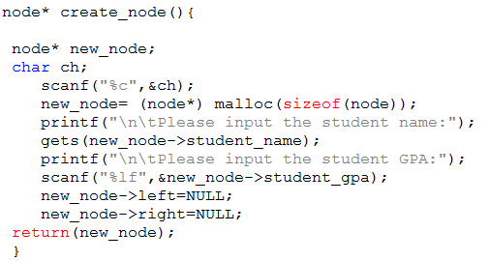

Slide 48
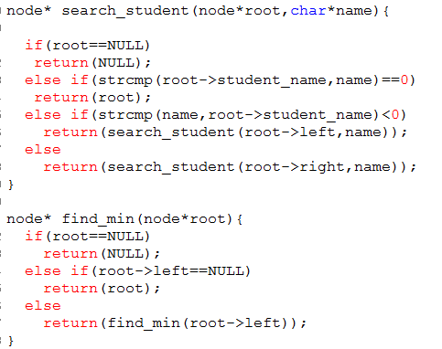

Slide 49
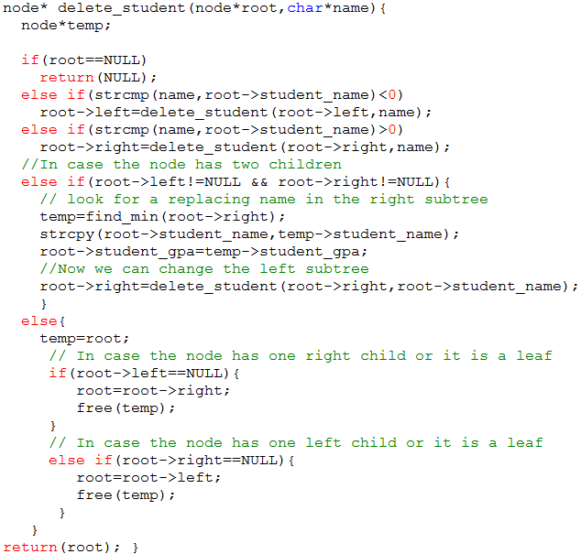

Slide 50
Binary Tree: Efficiency
Most operations with trees involve descending the tree from level to level to find a particular node
  During a search we need to visit one node in each level so we can get a good idea how long it takes to carry out these operations by knowing how many level there are
    If we have:
      1 node  1 level
      3 nodes  2 levels
      7 nodes  3 levels
        Number of nodes = 2 ^{number of levels} -1
        Number of levels= log₂(NumberOfNodes +1)
A tree provides high efficiency for all the common data-storage operations
  Traversing is not as fast as other operations
    However, traversals are more appropriate when a tree is used for algebraic expressions which are not too long anyway

